Slide 1
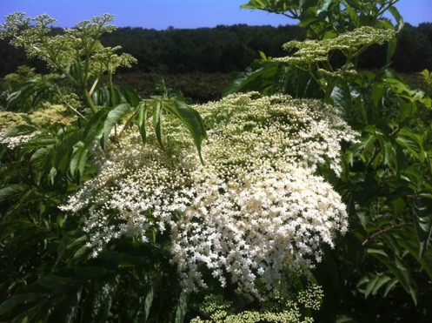
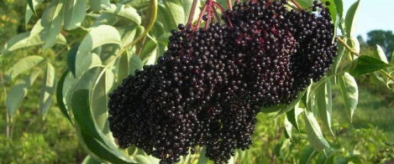
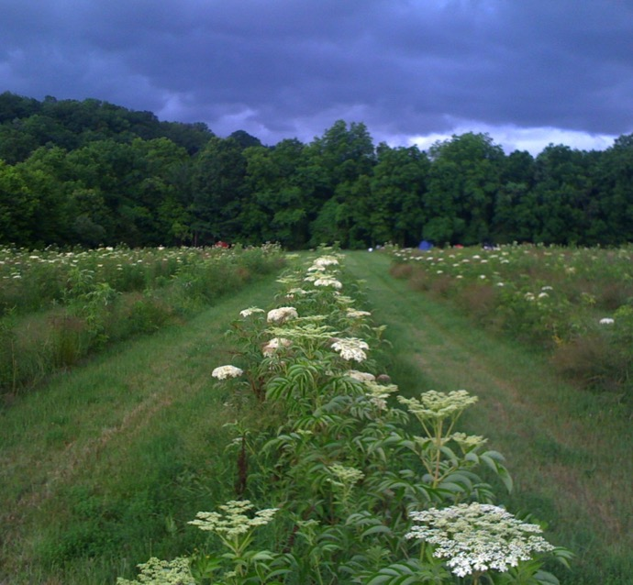
Cultivating Elderberry as a Cash Crop
Wealth to Farmers – Health to Communities
Presenter: Terry Durham
President, Missouri River Hills Elderberry Producers
Eridu Farms, Hartsburg, MO 65039
573-999-3034 eridu_farms@yahoo.com
www.riverhillsharvest.com

Slide 2
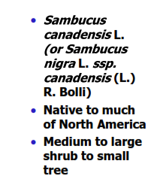
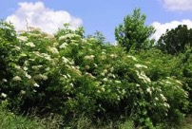
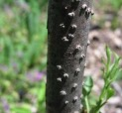
ELDERBERRY: historical & modern uses
www.riverhillsharvest.com
Notes:
2

Slide 3
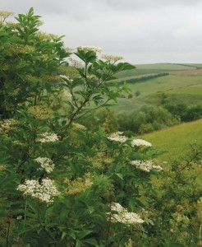
Hippocrates called the Elder
Tree his “medicine chest.”
If ever the soul of a plant has been fought for, it is elder. An important herb through the ages, it has been described as a whole medicine-chest in one plant. Less used now than formerly, its flowers remain a wonderful fever remedy and delicious in drinks or desserts. The berries work against flu and colds, and help relieve coughs. The leaves, as an ointment, are good for bruises.
Few plants are as steeped in folklore, legend and superstition as the elder. Its hollow stem was said to have been used by Prometheus to bring fire to man from the gods, and the Saxon aeld (‘fire’) may have given elder its name. The same empty stem was a ready-made flute, and the species name sambucus was chosen by Linnaeus for a flute made of elder.

Slide 4
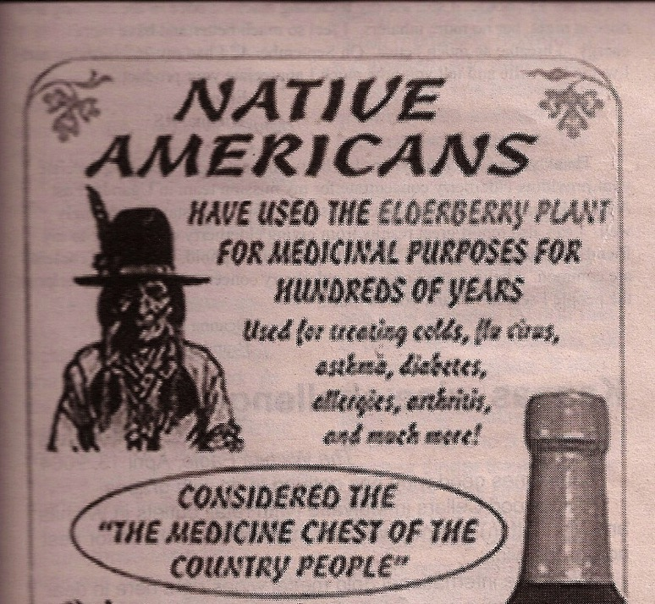
American Elderberry
Latin Name: Sambucas Canadensis
Common Name:
Elderberry, Black Elderberry
Properties
Antioxidant, diaphoretic.
diuretic, laxative, immune-
boosting, anti-inflammatory
Historical Uses:
Coughs, colds, flu,
bacterial infections, viral
infections, tonsillitis,
lowers cholesterol, improves
vision and heart health,
immune system booster
Indicated for:
Cancer, HIV, asthma and
bronchitis, inflammation of
the urinary tract and
bladder, nerve disorders,
back pain, joint and muscle
pain, colds and flu
coughs and sore throats
www.riverhillsharvest.com

Slide 5
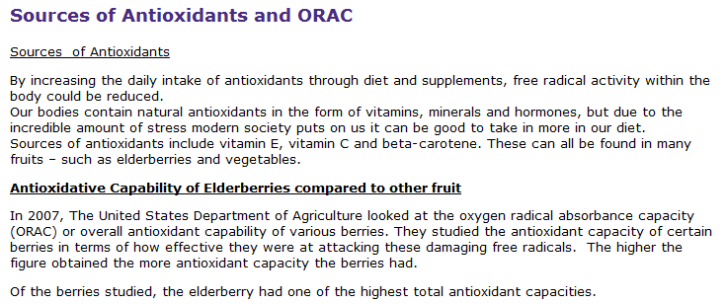
“People are tired of taking pills, they want to eat functional foods that contribute to their health.” Terry Durham, Columbia Daily Tribune
www.riverhillsharvest.com

Slide 6
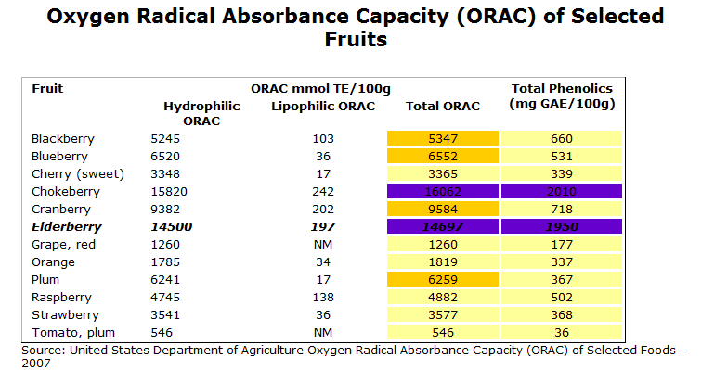
www.riverhillsharvest.com

Slide 7
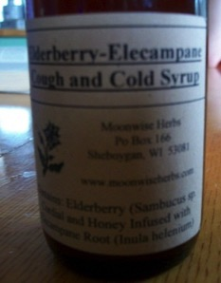
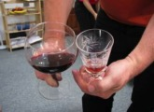
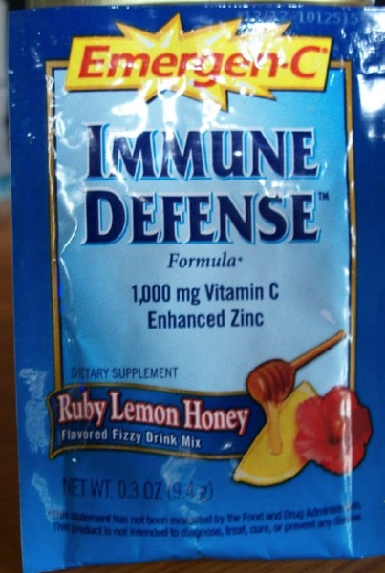
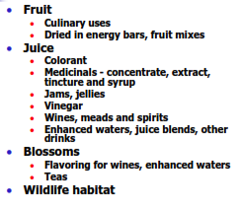
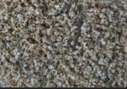
www.riverhillsharvest.com

Slide 8
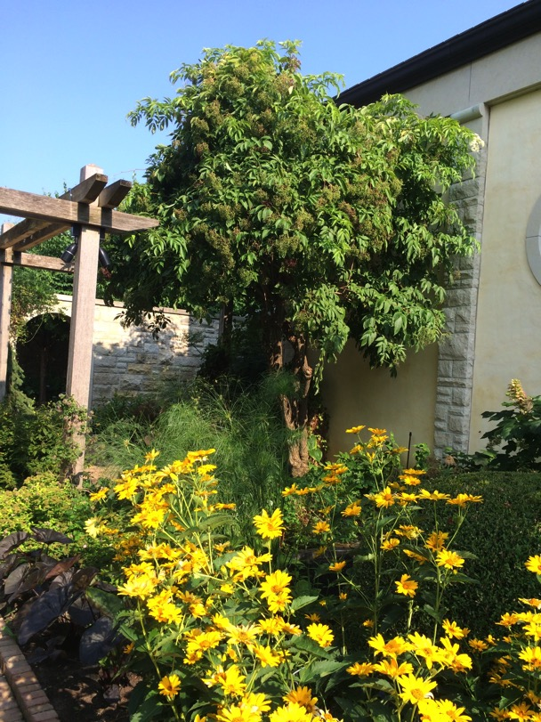
Landscape architects have begun to specify ‘edible’ elderberry (canadensis) to create wildlife habitat and feed people.
www.riverhillsharvest.com

Slide 9
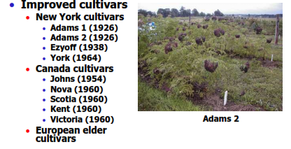
ELDERBERRY:
VARIETIES & SELECTIONS

Slide 10
‘Wyldewood’ Elderberry
www.riverhillsharvest.com

Slide 11
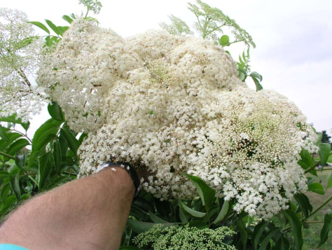
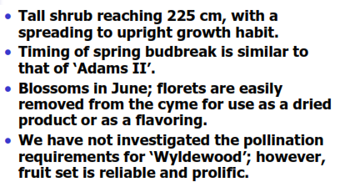
Dense flower cluster of ‘Wyldewood’

Slide 12
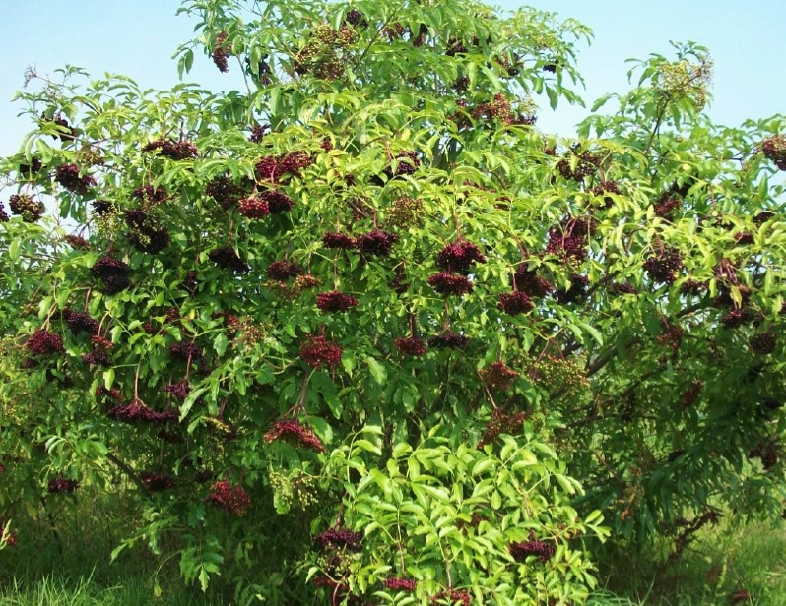
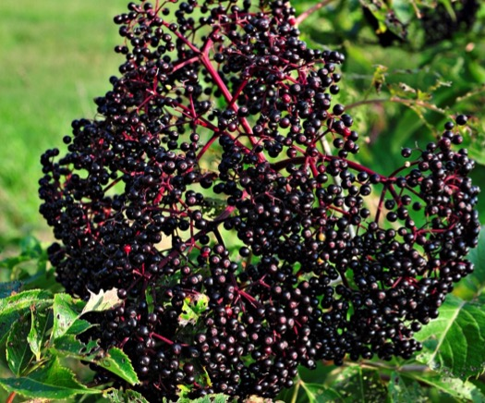
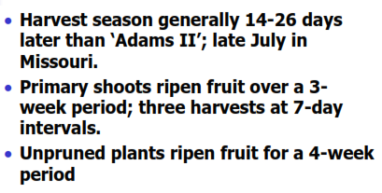
Wyldewood
www.riverhillsharvest.com

Slide 13
‘Wyldewood’
www.riverhillsharvest.com

Slide 14
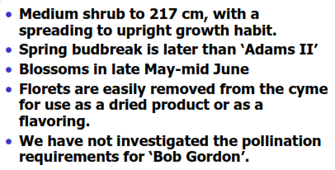
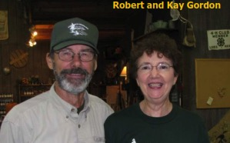
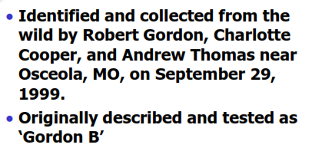
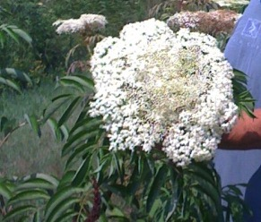
‘BOB GORDON’ Elderberry
An example of
Bob Gordon’s determinate flower head.
www.riverhillsharvest.com

Slide 15
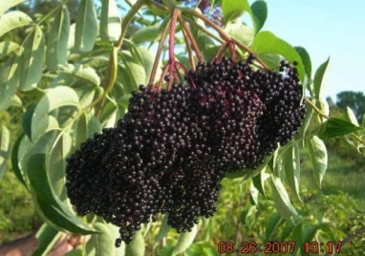
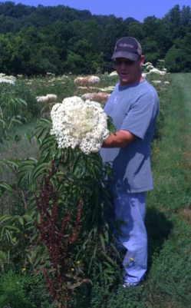
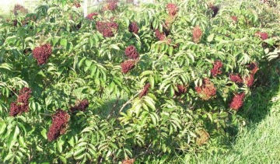
‘Bob Gordon’
www.riverhillsharvest.com

Slide 16
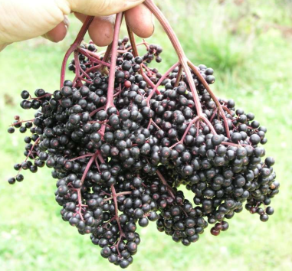
‘Bob Gordon’
www.riverhillsharvest.com

Slide 17
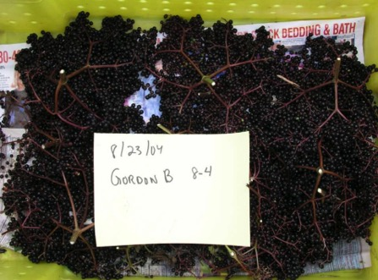
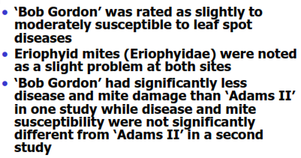
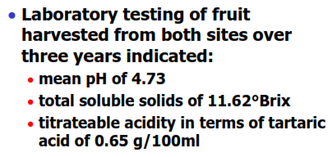
‘Bob Gordon’
www.riverhillsharvest.com

Slide 18
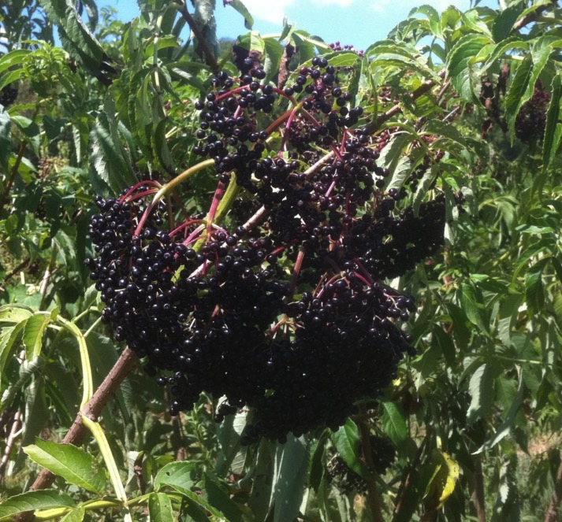
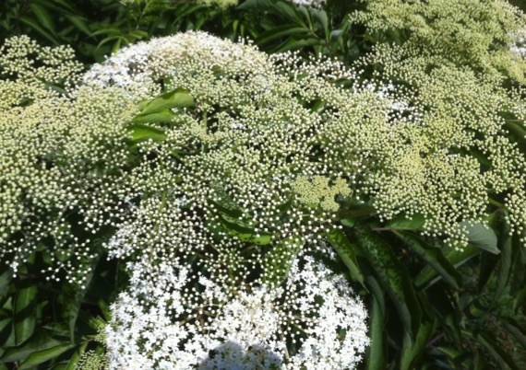
‘RANCH’ Elderberry
First to bloom
Determinate
Drought resistant/heat tolerant

Slide 19
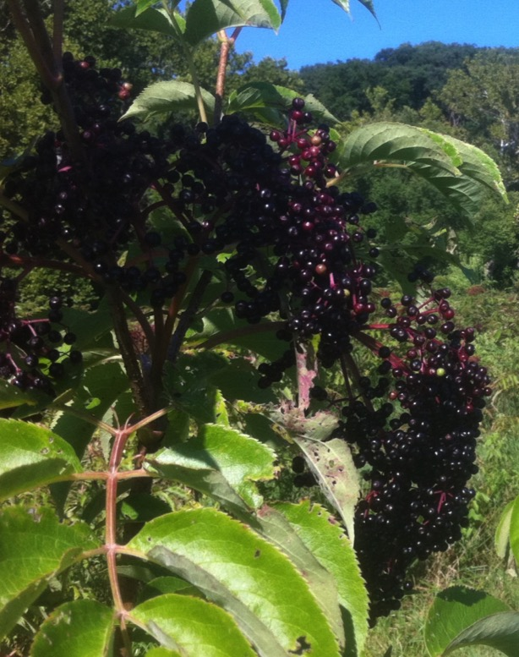
‘ADAMS II’ Elderberry
Released in 1926
Indeterminate
Similar to Wyldewood bloom time
Standard to which all varieties are tested
Continues to be one of the best varieties

Slide 20
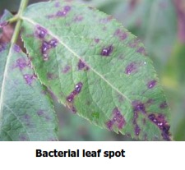
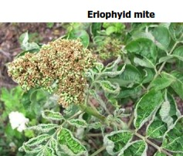
Pest Issues
www.riverhillsharvest.com

Slide 21
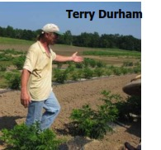
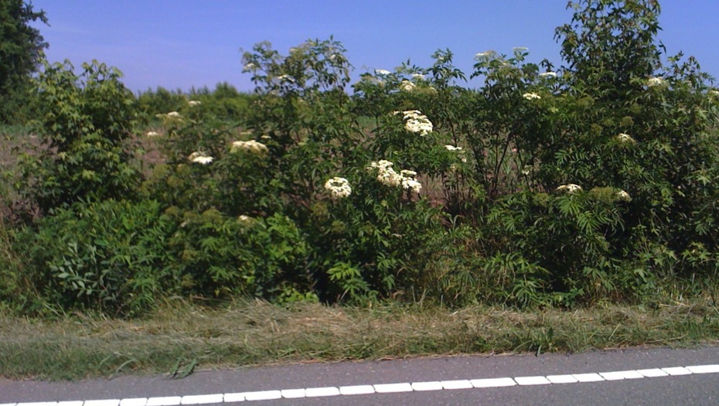
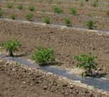
Elderberries in Missouri: Wild to Cultivated
Wild elderberries grow along roadways and near streambeds..

Slide 22
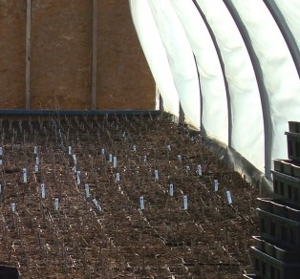
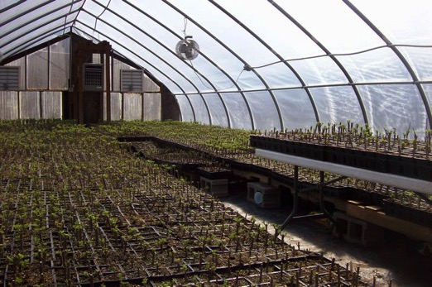
Propagation
Soil is mixed; cuttings are placed in the medium.
www.riverhillsharvest.com

Slide 23
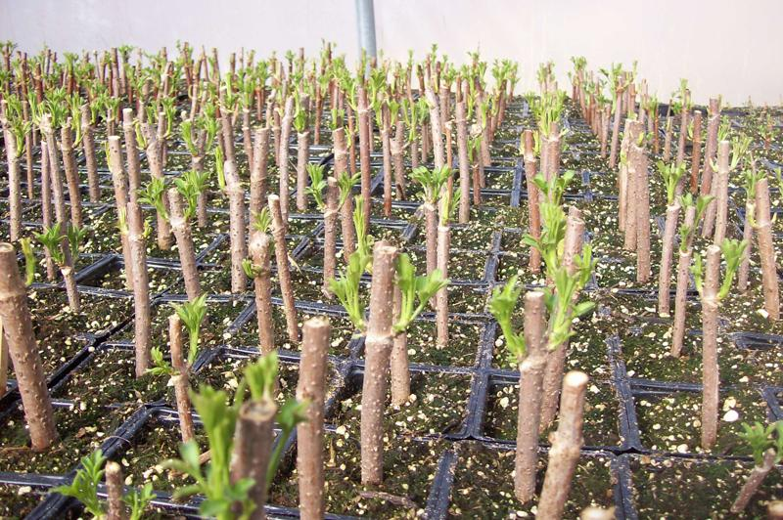
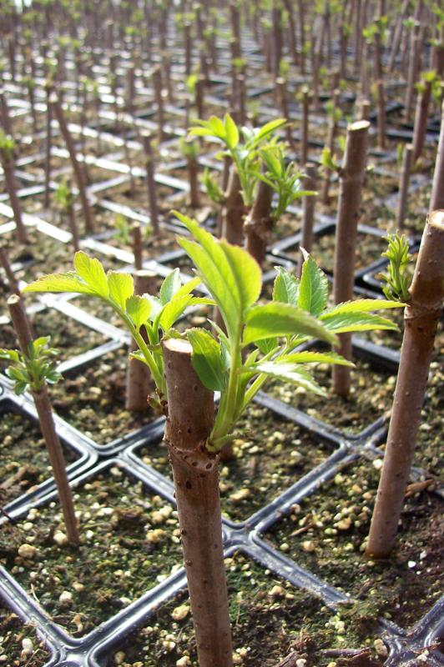
4-week old cuttings in greenhouse, roots are beginning to sprout.
Root stimulation growth medium is used to ensure a healthy start.

Slide 24
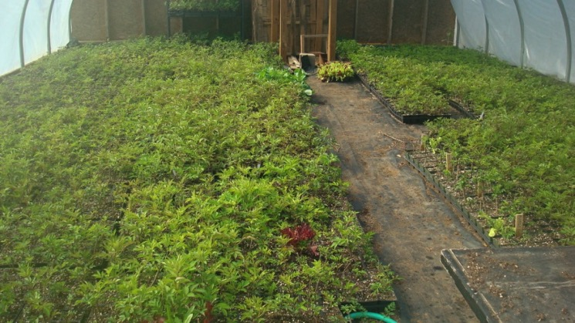
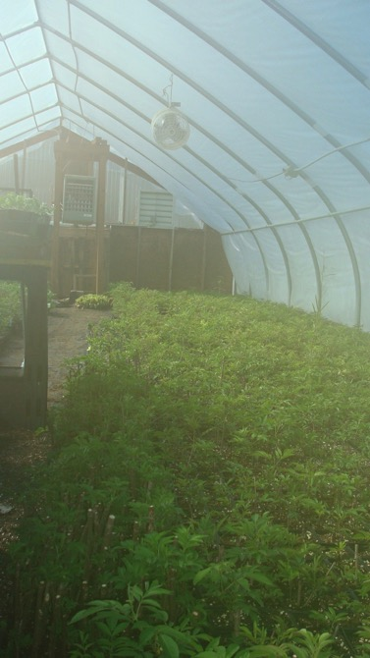
After ten to twelve weeks in the green house; cuttings are ready to plant in the orchard.
www.riverhillsharvest.com

Slide 25
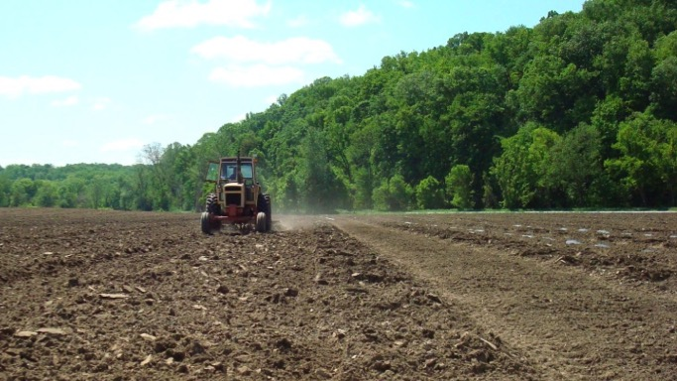
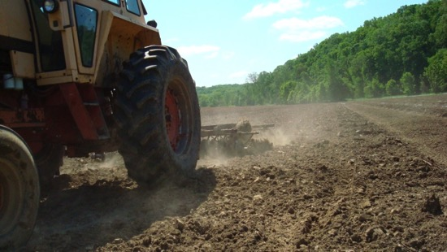
Field Preparation

Slide 26
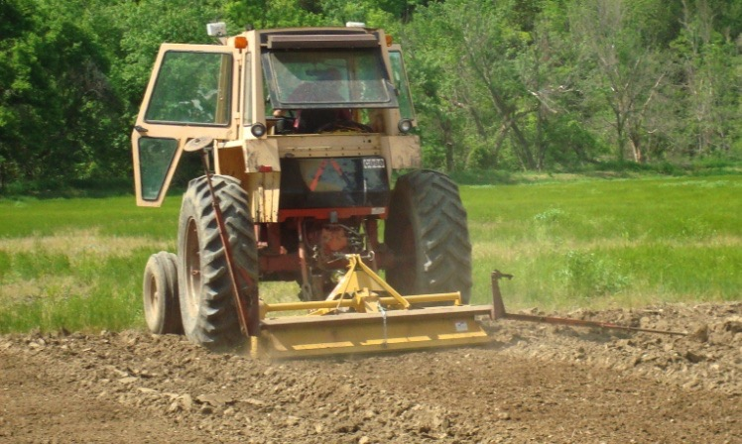
Tilling is complete.
Notice the row marker that helps define proper spacing.

Slide 27
The black plastic weed barrier is laid.
Cuttings will be planted next.

Slide 28
A water wheel planter is used to set up to 1000 plants per hour.
Loading the waterwheel planter, which allows two
people to set up to 1000 plants in an hour.

Slide 29
On the planter.
The well rooted cuttings set easily with this planter.

Slide 30
Here the cover crop was well established before preparing the beds for planting.
www.riverhillsharvest.com

Slide 32
Rooted cuttings
set in black plastic.

Slide 34
The side discharge mulching machine.
www.riverhillsharvest.com

Slide 35
www.riverhillsharvest.com

Slide 36
Mowing Season. The orchard is beginning to flower.
www.riverhillsharvest.com

Slide 37
Berry set. Notice how stems turn purple as berries ripen.
Berry set and flowers on the same cyme, notice the umbel shape.
www.riverhillsharvest.com

Slide 38
3-year-old nursery plants.

Slide 39
Cymes can grow quite large: 2000 or more small individual flowers in a cyme.
Very Striking as a landscape specimen.
www.riverhillsharvest.com

Slide 40
A specimen with ripe berries
almost ready for harvest.
A specimen in full flower beginning to set berries

Slide 41
Nearing Ripeness
Determinate Ranch
Indeterminate
Wyldewood

Slide 42
Qualities of Ripeness
Dark
Dusky
Not red or green

Slide 43
Elderberries are very easy to grow. They are perennial, are excellent at preventing soil erosion and for filtration; better in fact than grasses. They are beautiful and graceful in our landscapes. Elderberries are also great windbreaks, they make excellent habitat and attract more beneficial creatures than just about any native American berries. Plant some today.
Printable version on our website
www.riverhillsharvest.com

Slide 44
The fruits of your labor:
Buckets
of harvested berries.

Slide 45
De-stemming Machine 2011 Prototype
www.riverhillsharvest.com

Slide 46
2014 De-stemmer
www.riverhillsharvest.com

Slide 47
From field to freezer in the same day.
www.riverhillsharvest.com

Slide 48
Berries fall through
a screen into tubs for
transport to the wash station.
The stems are swept from the machine into tubs for removal.

Slide 49
Sanitized, washed, and dried berries
are put into 25 pound food grade buckets
and frozen for transport to underground
deep freezer storage.

Slide 50
www.riverhillsharvest.com

Slide 51
Field Tour & Training develop knowledge and skills in Elderberry culture and harvest techniques
www.riverhillsharvest.com

Slide 52
Registration information:
2015
elderberryworkshop.
wordpress.com
(no spaces or caps)
Call 573-424-9693 for info.
Mail in registration and fees.
www.riverhillsharvest.com

Slide 53
Any Questions
???
www.riverhillsharvest.com

Slide 54
Thanks for attending the
Cultivating Elderberry as a Cash Crop Seminar
Wealth to Farmers – Health to Communities
www.riverhillsharvest.com

